Slide 1
S&P500 Stock Analysis
Swami Venkatesan
10/19/2023

Slide 2
Outline
S&P 500 Overview
Data Processing
Sector-wise Analysis
Stock Performance Distribution and Labels
Stock Clustering by Trend
Combined Model for Improved Classification
Summary and Areas of Improvement

Slide 3
Overview
Standard and Poor's 500 (S&P500) is a stock market index that tracks 500 leading publicly traded companies in the U.S
The S&P 500 uses a market-cap weighting method, giving a higher percentage allocation to companies with the largest market capitalizations
These stocks belong to one of the 11 different sectors

Slide 4
Data Mining and Wrangling
The latest list of S&P500 companies is downloaded from a scraper
2 year daily market data (OCHLV) for all stocks is then retrieved using Yahoo Finance API
To account for any sudden price changes, the following steps were taken
Average of daily High and Low price to reduce intraday volatility
Simple moving average of 15 days (SMA10) to reduce day to day volatility
SMA10 prices were used for 2-year stock performance calculations and labeling

Slide 5
Sector Composition and Weights
Sector | Sum of Stock Weights | Number of Stocks in Sector | Percentage of Stocks in SP500
Communication Services | 9% | 22 | 4%
Consumer Discretionary | 11% | 53 | 11%
Consumer Staples | 6% | 38 | 8%
Energy | 5% | 23 | 5%
Financials | 11% | 72 | 14%
Health Care | 13% | 64 | 13%
Industrials | 8% | 77 | 15%
Information Technology | 28% | 64 | 13%
Materials | 2% | 29 | 6%
Real Estate | 2% | 31 | 6%
Utilities | 2% | 30 | 6%
Stocks in IT sector have the maximum weightage on S&P500
IT, Industrial, Financial and Healthcare have the

Slide 6
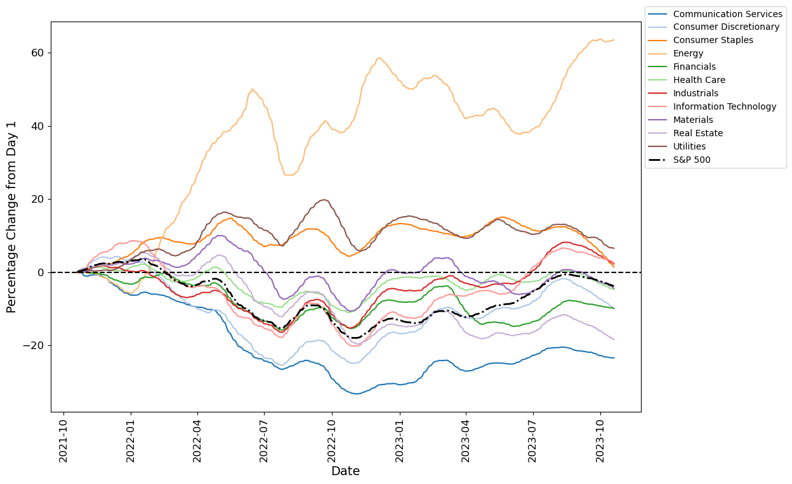
2 Year Performance by Sector
Energy sector stocks show the highest gains
Comm Service stocks show the lowest gain
S&P index seems to follow higher weightage sectors – IT, healthcare and Financials
Sector | 2y % Change
Sector | Mean | Median
Communication Services | -23% | -17%
Consumer Discretionary | -10% | -10%
Consumer Staples | 2% | 7%
Energy | 64% | 62%
Financials | -9% | -12%
Health Care | -3% | -12%
Industrials | 3% | 2%
Information Technology | 3% | -5%
Materials | -4% | -11%
Real Estate | -18% | -18%
Utilities | 8% | -1%

Slide 7
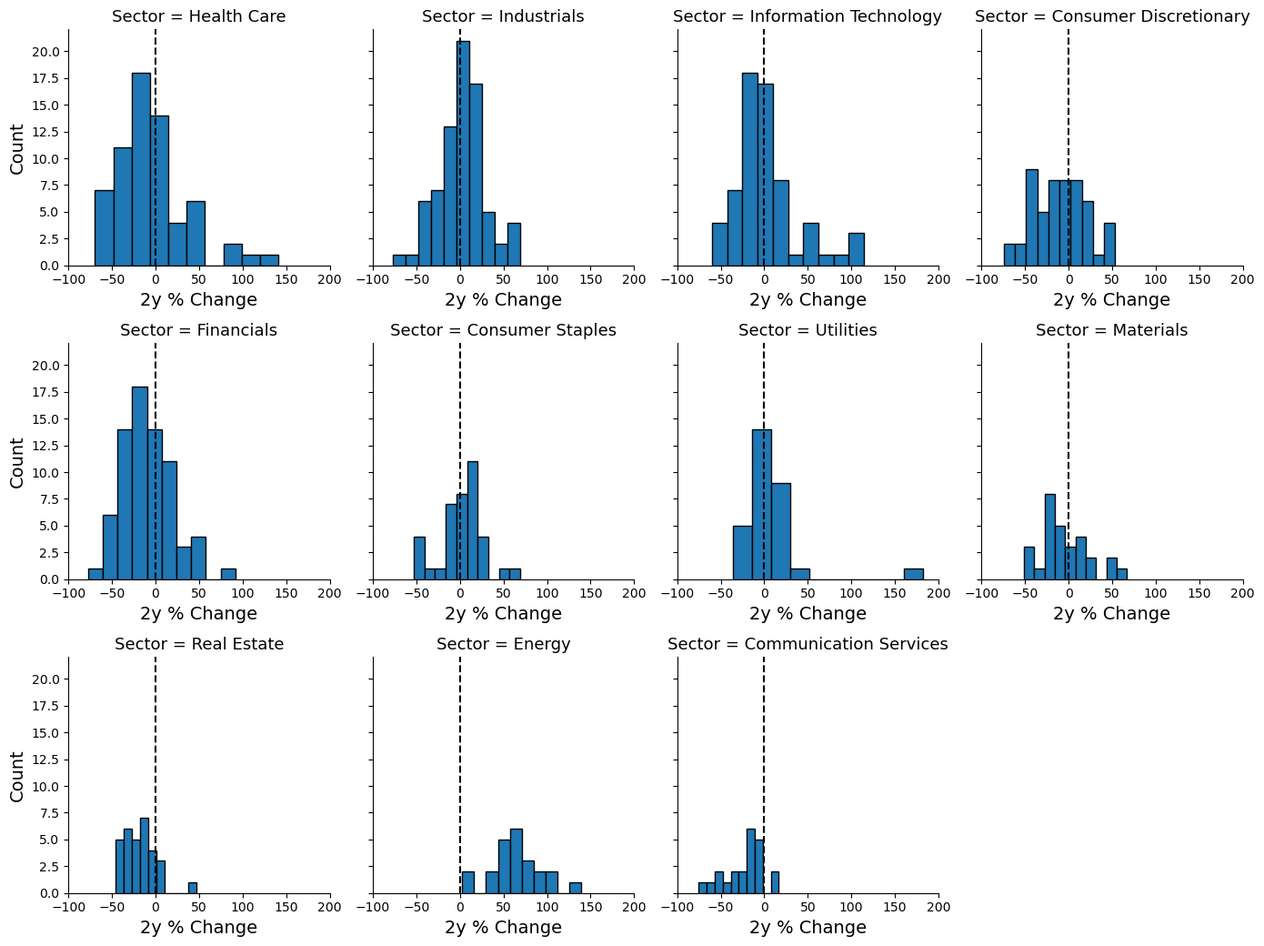
Sector Wise Stock 2y Performance Distribution
Plot shows distribution of stocks vs 2-year percentage change
All stocks in Energy sector show positive performance ( >0%)
Majority of the stocks in Real Estate and Comm. Services show negative performance
All other sectors are distributed between positive and negative

Slide 8
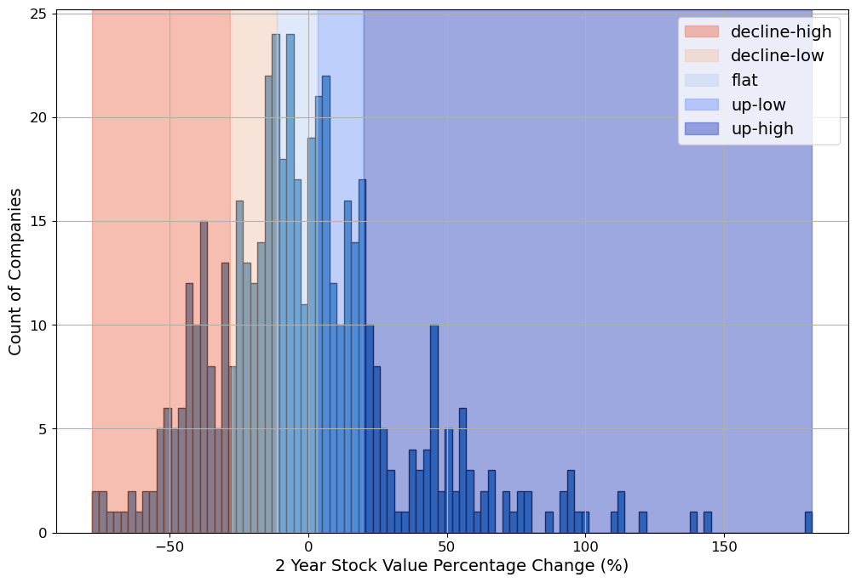
Stock Performance Labels
The percentage change between the price of the stock from initial price(Oct 18, 2021) to end of 2-year price was calculated
The stocks were then automatically assigned to 5 different labels based on their 2-year performance (% change)
The binning was done by splitting the stocks into 5 quantiles
Performance Label | 2y % Change Bins
 | Min | Max
decline-high | -80% | -31%
decline-low | -31% | -14%
flat | -14% | 1%
up-low | 2% | 18%
up-high | 18% | 165%

Slide 9
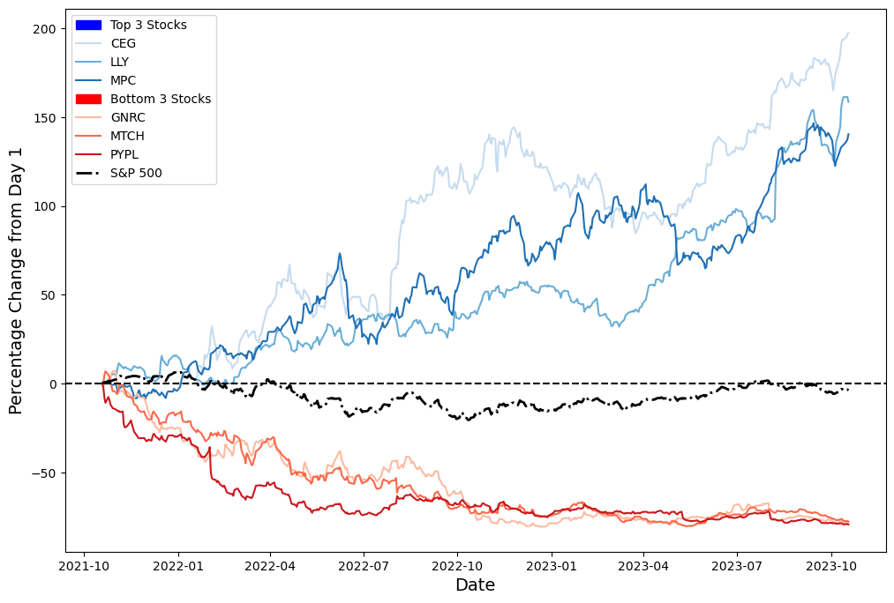
Top 3 and Bottom 3 Performing Stocks
Top 3 and bottom 3 performing stock is plotted
The daily change is calculated as percentage change from Day 1 (Oct 18,2021) prices
The 6 stocks belong to different sectors
Ticker | Price_{Oct 18 2021} | Price_{Oct 18 2023} | 2y % Change | Sector | Weightage
CEG | $39.25 | $110.57 | 182 | Utilities | 0.10
LLY | $234.79 | $572.23 | 144 | Health Care | 1.34
MPC | $63.51 | $151.17 | 138 | Energy | 0.16
MTCH | $159.85 | $40.12 | -75 | Comm. Services | 0.03
GNRC | $468.32 | $107.43 | -77 | Industrials | 0.02
PYPL | $271.36 | $59.37 | -78 | Financials | 0.17

Slide 10
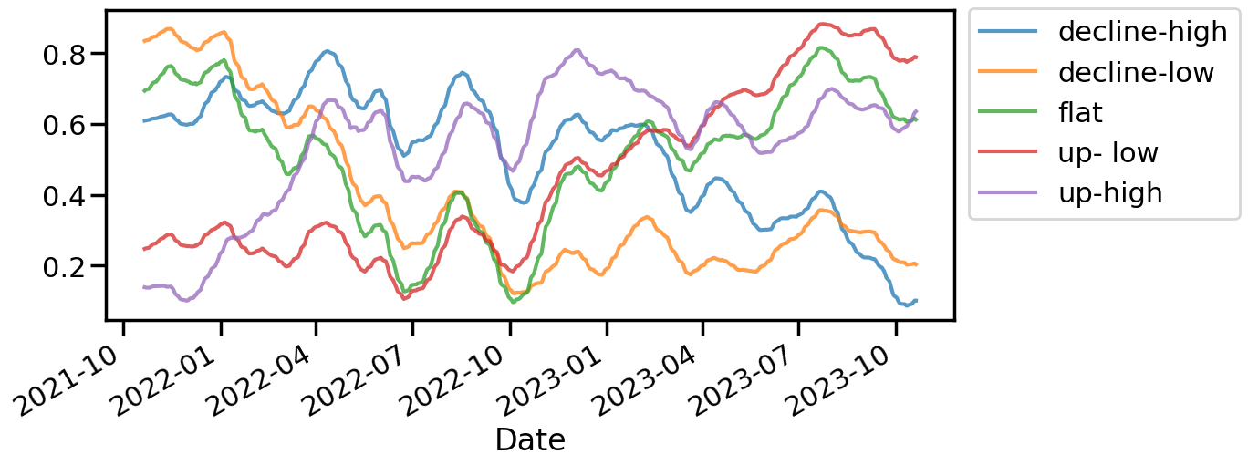
Time Series Clustering
To segment the stocks based on similarities in their trend, time series clustering method was used
Euclidean distance was used as the series is smoothened to remove short term volatility
Time series clustering was done on the 2 year market data (freq = daily)
Each stock’s timeseries was normalized between 0 and 1
5 clusters were used to match with binned labels earlier identified
The clusters were then labeled similar to the 2y performance label based on the 2y % change

Slide 11
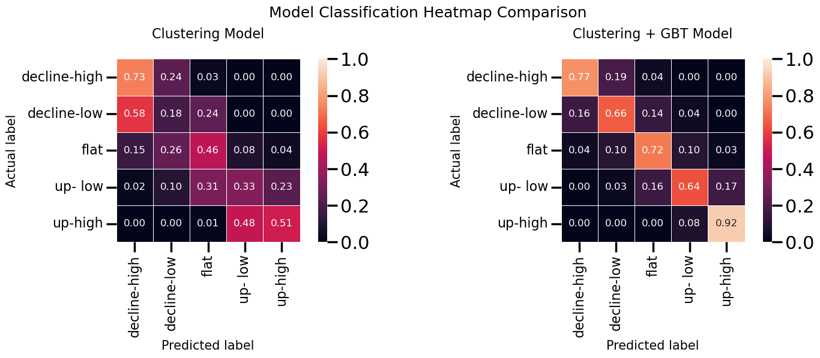
Model Metrics
All the stocks were then assigned to the cluster using the time series clustering algorithm
Accuracy of the clustering algorithm is ~ 45%
Gradient Boosted Tree (GBT) model was also developed using the clustering labels as one of the feature (Clustering + GBT)
The model was trained on 80% of data and showed 62% accuracy on the remaining unseen 20% data
Overall accuracy of the combined Clustering + GBT = 74%
Significant improvement in classifying mid labels – decline-low, flat and up-low
Model | Accuracy
Clustering | 45%
Clustering + GBT | 74%

Slide 12
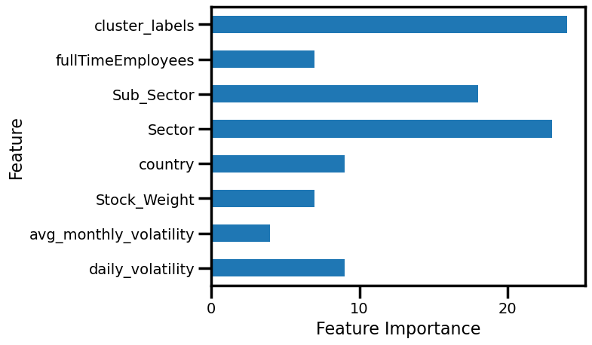
Feature Importance
The importance index from Catboost (GBT) model of each feature is plotted
Cluster labels from time series clustering show the highest importance, followed by Sector and Sub-Sector

Slide 13
Summary
An analysis on S&P500 stocks and sector performance was done
Stocks were labelled based on their 2y performance
Time series clustering was used to cluster the stocks based on their market trends and the quality of the clustering was evaluated against the 2y performance
The accuracy of the performance labelling was improved using the cluster labels as a feature along with other stock related features – sector, sub-sector,price volatility etc.
The model can be further improved by adding more static and dynamic features
Historical relative sector strength
Market Cap
Earnings Trend
Balance Sheet information

